Slide 1
Software Architecture
Project 1
Sai raghavendra sankrantipati

Slide 2
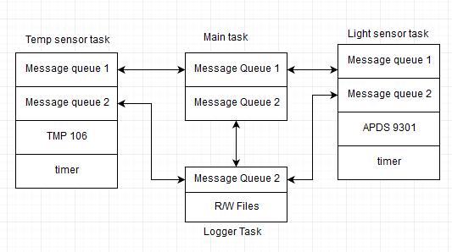
Block Diagram

Slide 3
Message Queue
typedef struct{
Source_Id_t src_id;
Msg_Id_t msg_id;
Char msg[10];
} Log_Message
Typedef struct{
Source_Id_t src_id;
Heatbeat_Id_t hb_id;
} hb_message;
Typedef enum{
MODULE_STATUS,
GET_LIGHT,
GET_TEMP,
.
.
}Msg_Id_t
Typedef enum{
TEMP_TASK,
LIGHT_TASK,
LOG_TASK,
MAIN_TASK,
} Source_Id_t
Typedef enum{
ALIVE,
DEAD,
} Heartbead_Id_t

Slide 4
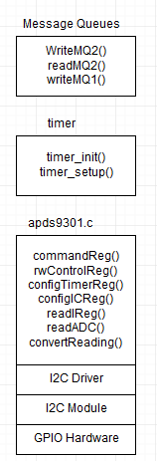
LIGHT SENSOR TASK

Slide 5
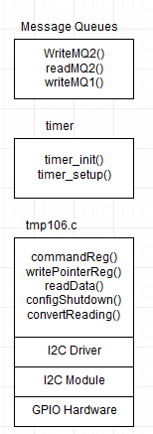
Temp Sensor Task

Slide 6
Logger Task Main Task
readMQ2() readMQ2()
WriteMQ1() /*Analyze messgage*/
writeMQ2() /*Change USR LED*/
writeFile() writeMQ1()

